Slide 1
DASHBOARD
TABLEAU HR SCORECARD : MEASURING SUCCESS IN TALENT MANAGEMENT

Slide 2
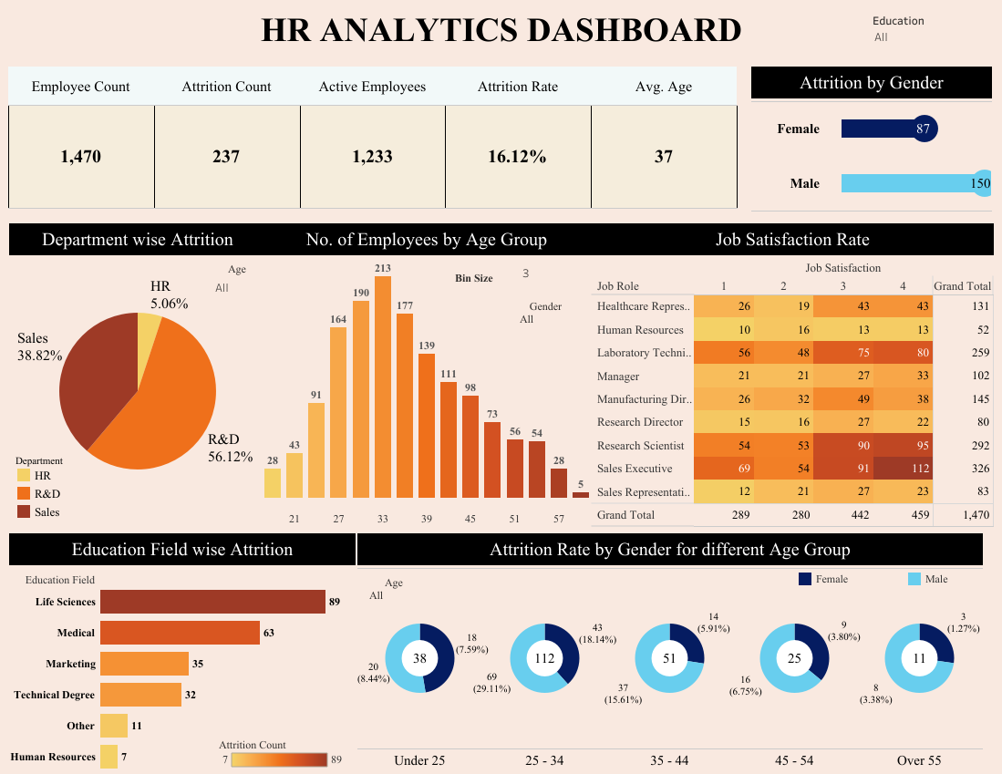

Slide 3
STORY LINE
TABLEAU HR SCORECARD : MEASURING SUCCESS IN TALENT MANAGEMENT

Slide 4
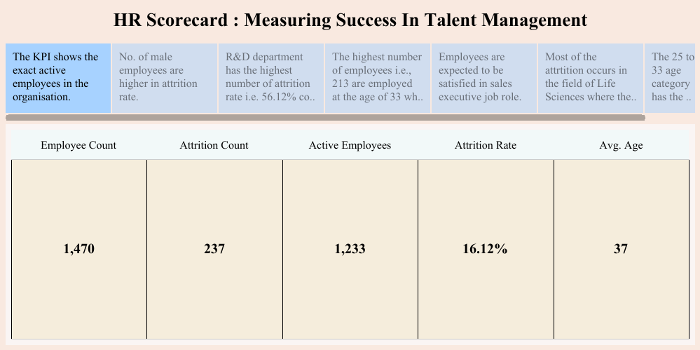

Slide 5
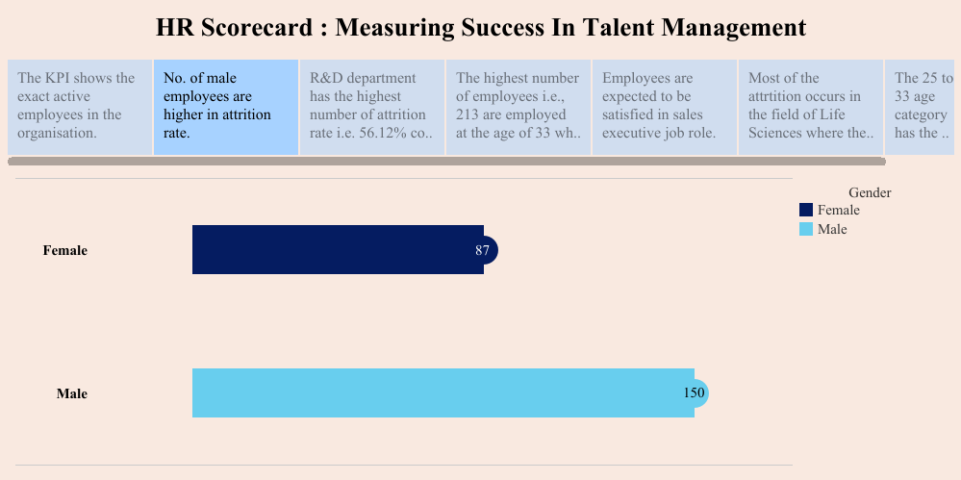

Slide 6
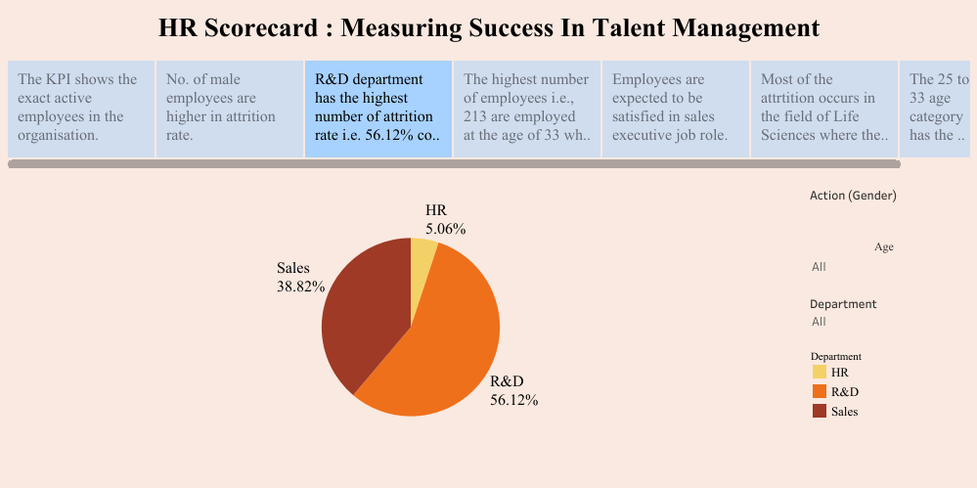

Slide 7
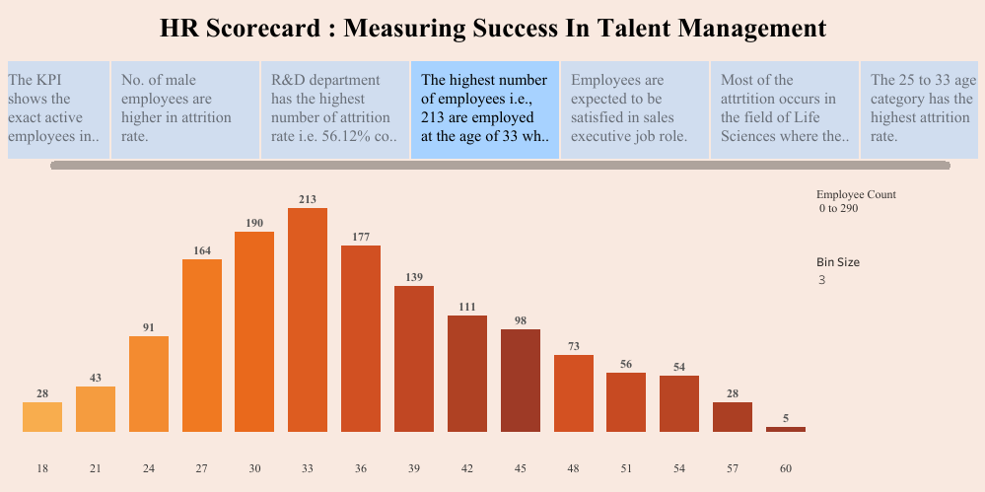

Slide 8
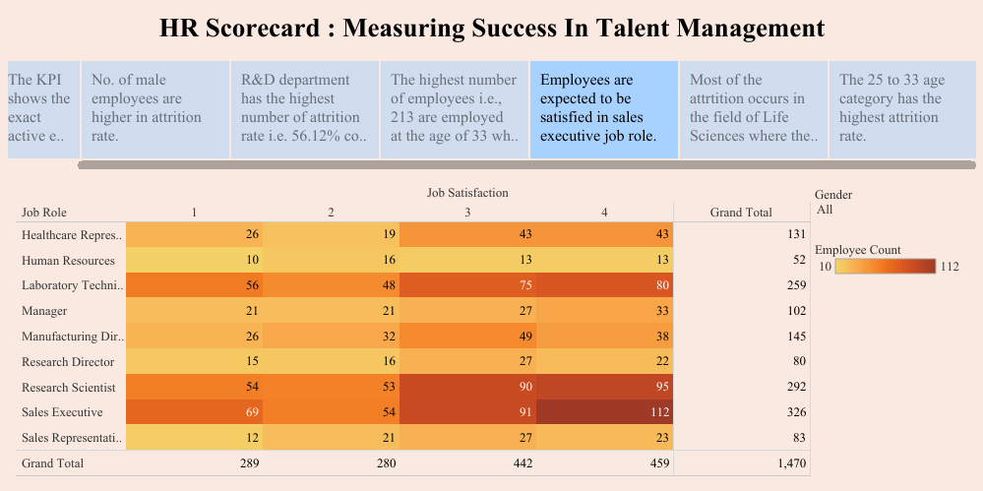

Slide 9
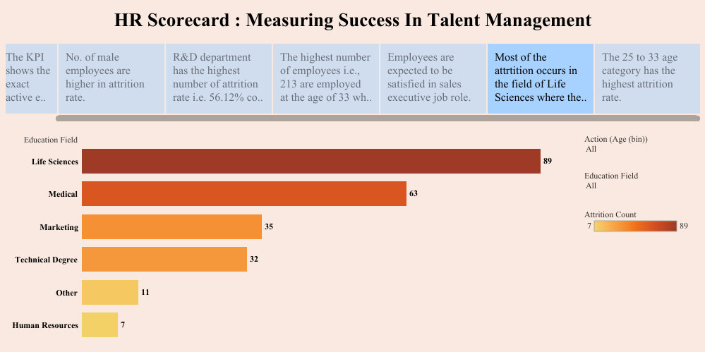

Slide 10
